Slide 1

MMS Solutions
Mobile Service Center
Over 10 years of experience with six outlets in Chennai
Comprehensive repair services: screens, buttons, speakers, cameras, batteries and more
Device customisation using authorized, original parts
Free quotes & on‑the‑spot repairs for selected issues
[1]

Slide 2

Overall Marketing Analysis
Target market: individuals & businesses in Chennai
Brand positioning: 10+ years, quick service, genuine parts; low digital visibility
Channels: local outlets & a basic website; grow via social media, ads & local SEO
Challenges: SEO underperformance and limited customer engagement
[1]

Slide 3

Website Performance
Mobile performance is very low (30/100) due to long blocking times and heavy resources.
Desktop performance is moderate (68/100) but still slowed by blocking scripts.
Optimise by removing unused JS/CSS, minimising JS execution and compressing images.
[2] [3]

Slide 4

Accessibility
Add accessible names to buttons and interactive elements.
Improve contrast ratios between text and backgrounds.
Restructure headings to follow a logical order for screen readers.
[4]

Slide 5

SEO
Page blocked from indexing – remove disallow rules.
Add descriptive meta descriptions to improve click‑through rates.
Ensure all links are crawlable and use descriptive anchor text.
[5]

Slide 6

Best Practices & Security
Implement HTTP Strict Transport Security (HSTS) to enforce secure connections.
Include source maps for first‑party JavaScript to aid debugging.
Reduce unused JavaScript and CSS to improve load times.
[6]

Slide 7


Responsive Design & User Experience
Adapts gracefully to mobile, tablet and desktop with no horizontal scroll.
Hamburger menu on mobile provides clear navigation and easy access to content.
Calls to action and forms are easy to tap and interact with on touchscreens.
Maintain consistency across breakpoints and optimise images for all devices.
[7]

Slide 8
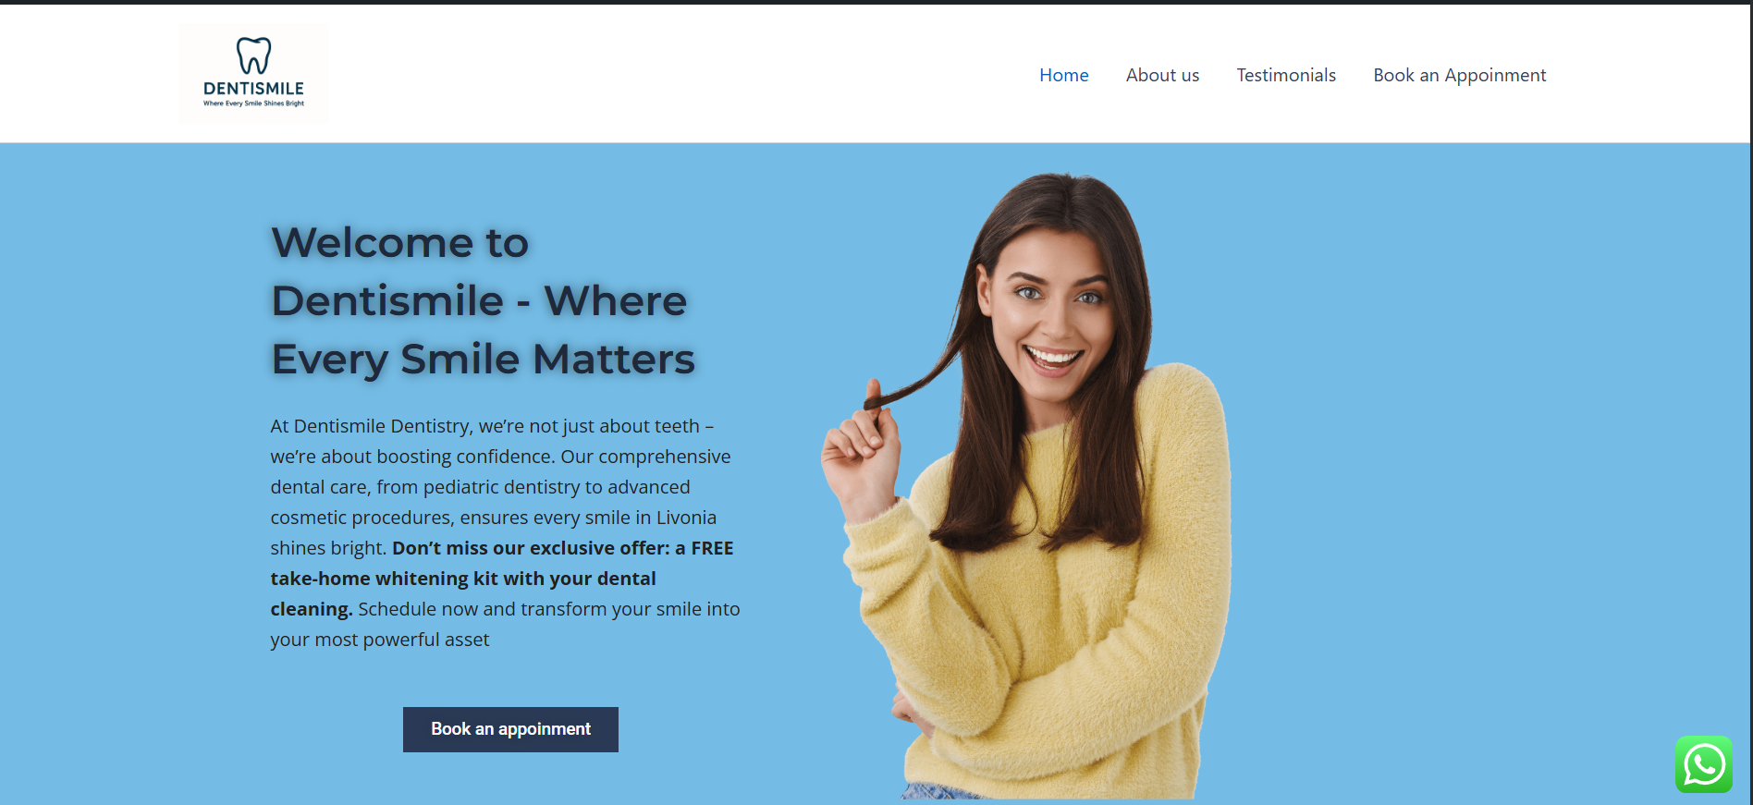

Slide 9
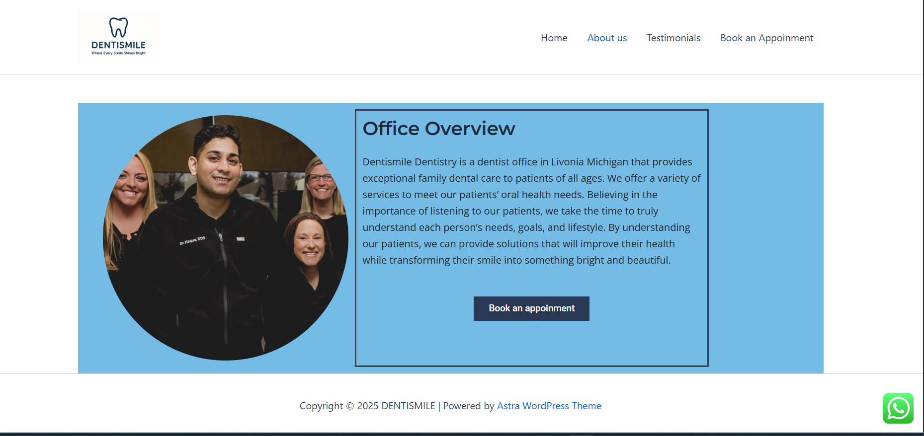

Slide 10
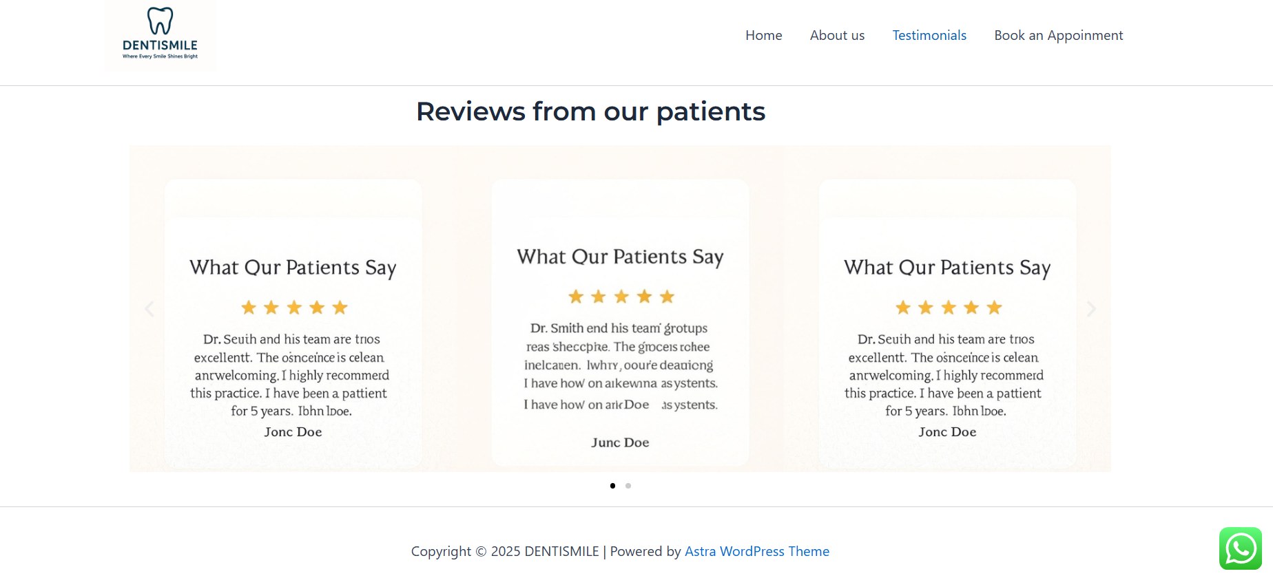

Slide 11
